Slide 1

POVs and Experience Prototypes:
The music creator experience
Elsie, Alix, Jialin, Constance

Slide 2
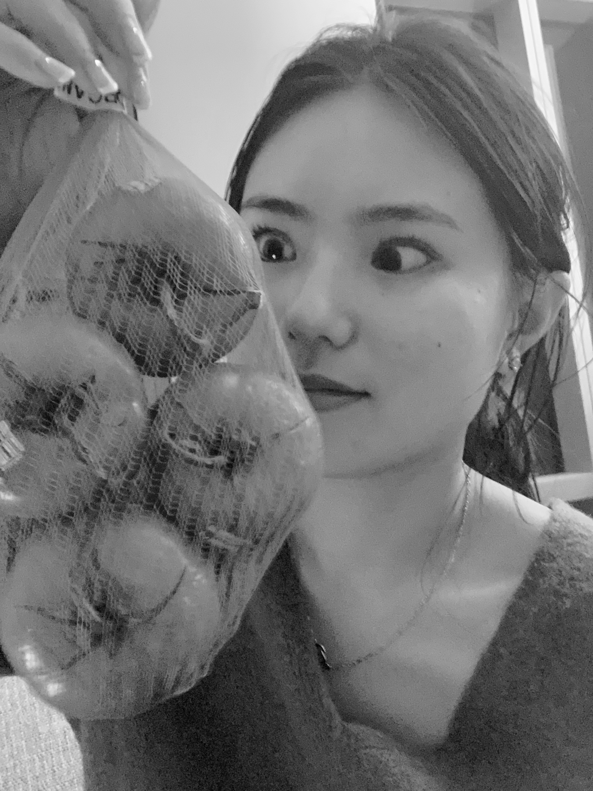
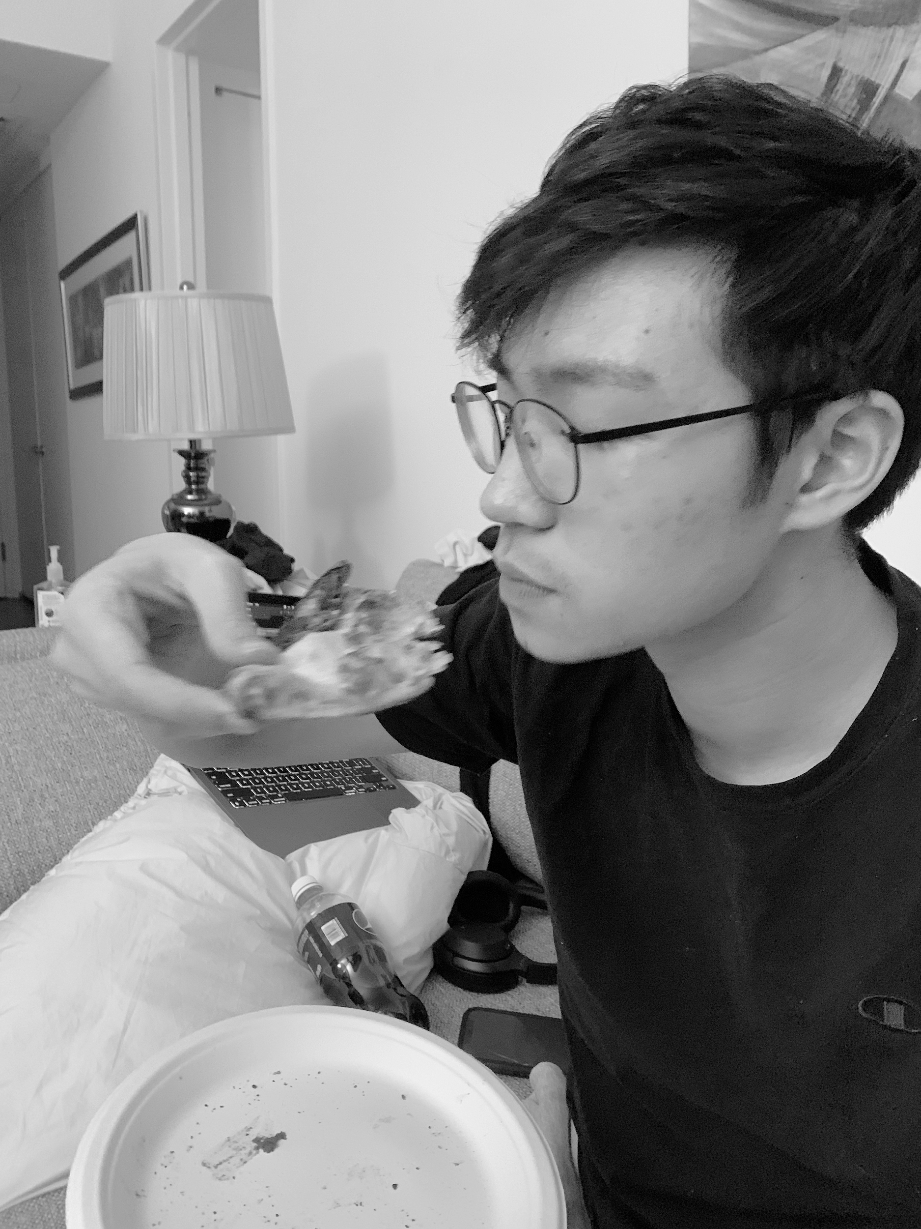
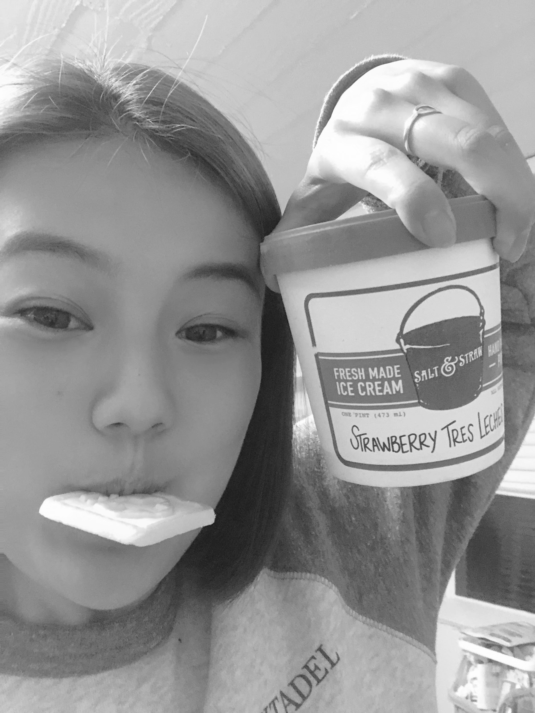
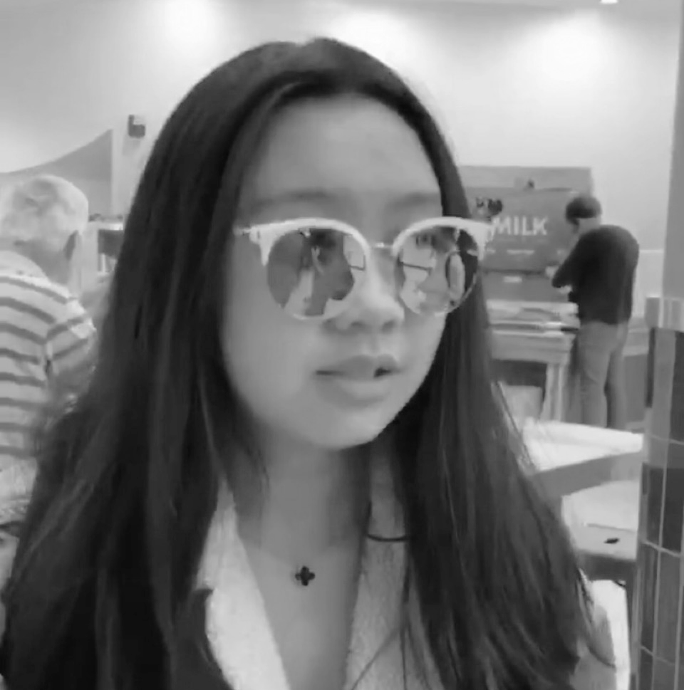
Hello from team 3 👋
Elsie W.
SymSys
Alix C.
CS
Jialin Z.
CS
Constance H. CS

Slide 3
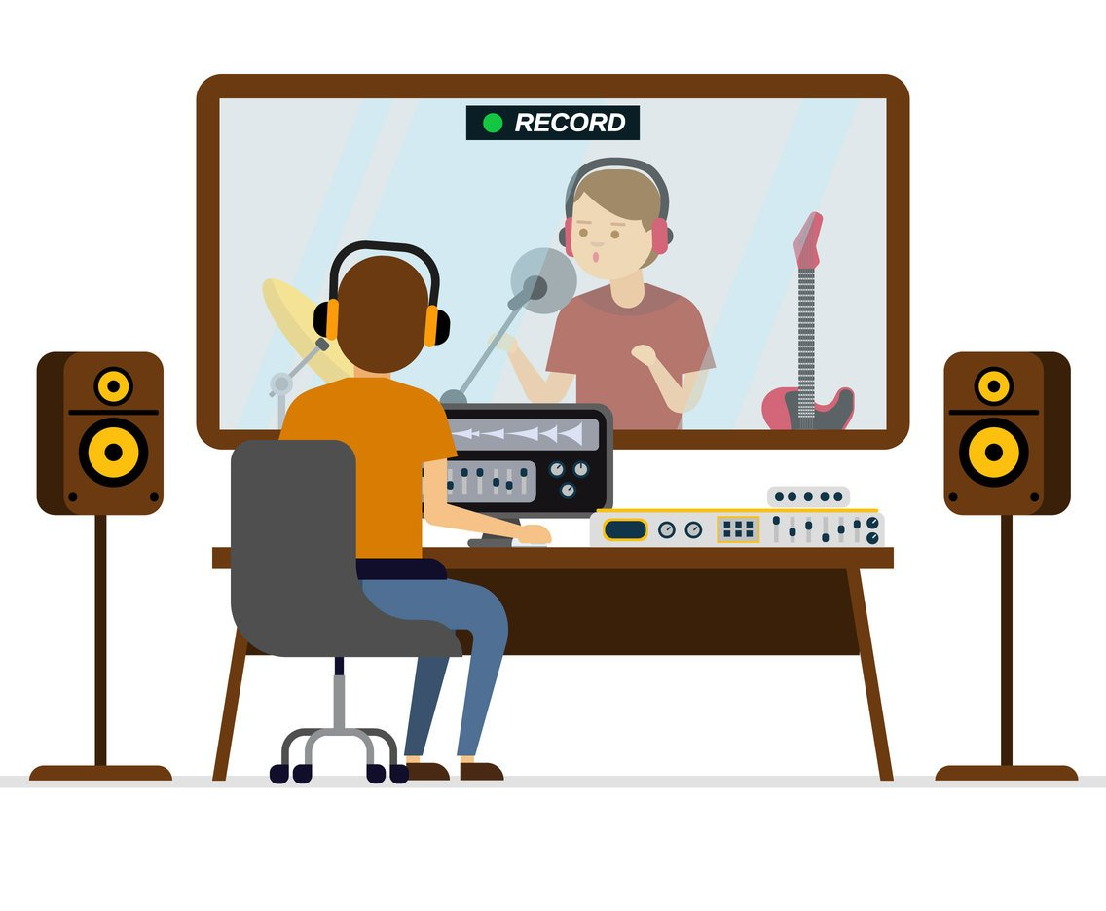
Domain: Music Creator Experience STUDIO: ART & CULTURE

Slide 4
initial POV

Slide 5
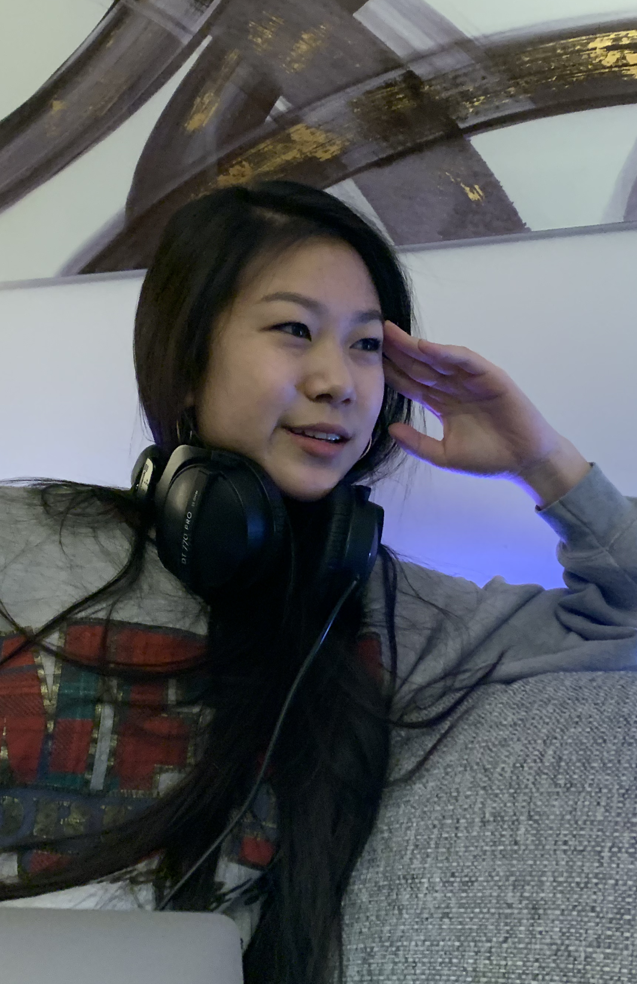
We met...
Gloria, an avid producer and freelancer on fiverr.
We were amazed to realize...
she feels like she has no choice but to sacrifice creative control and comfort to get recognized and paid for making music.
It would be game- changing to...
redesign the musician work model to empower the artist.

Slide 6
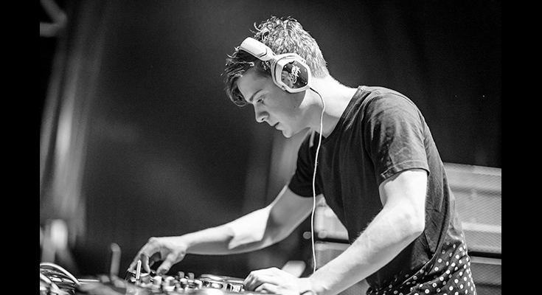
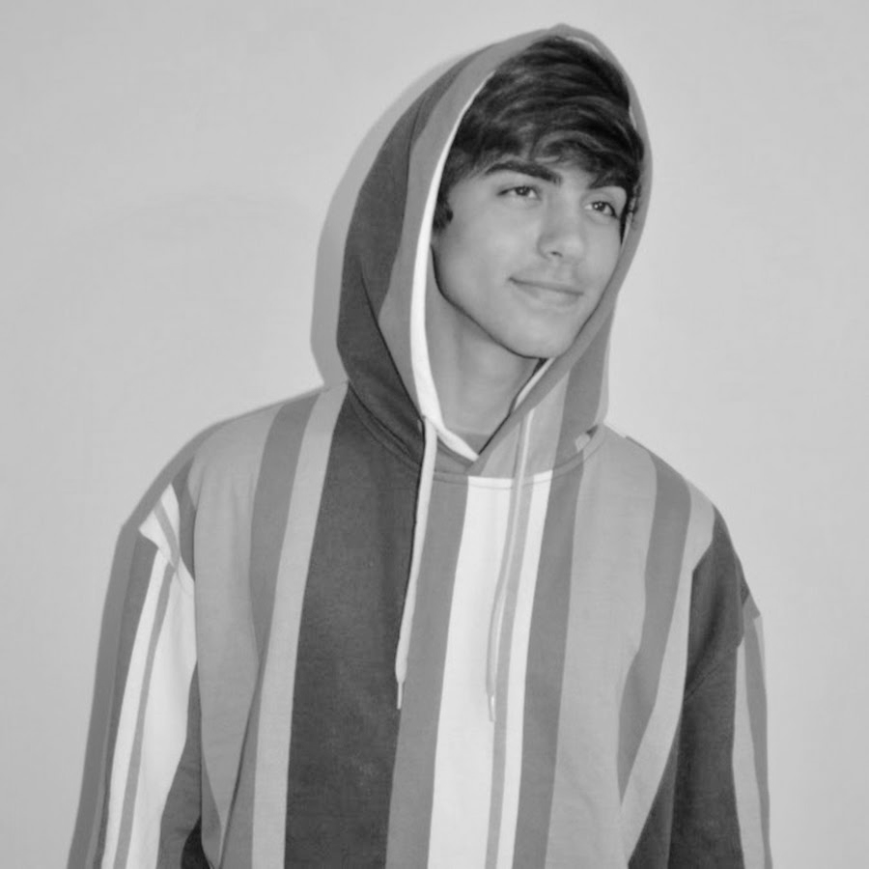
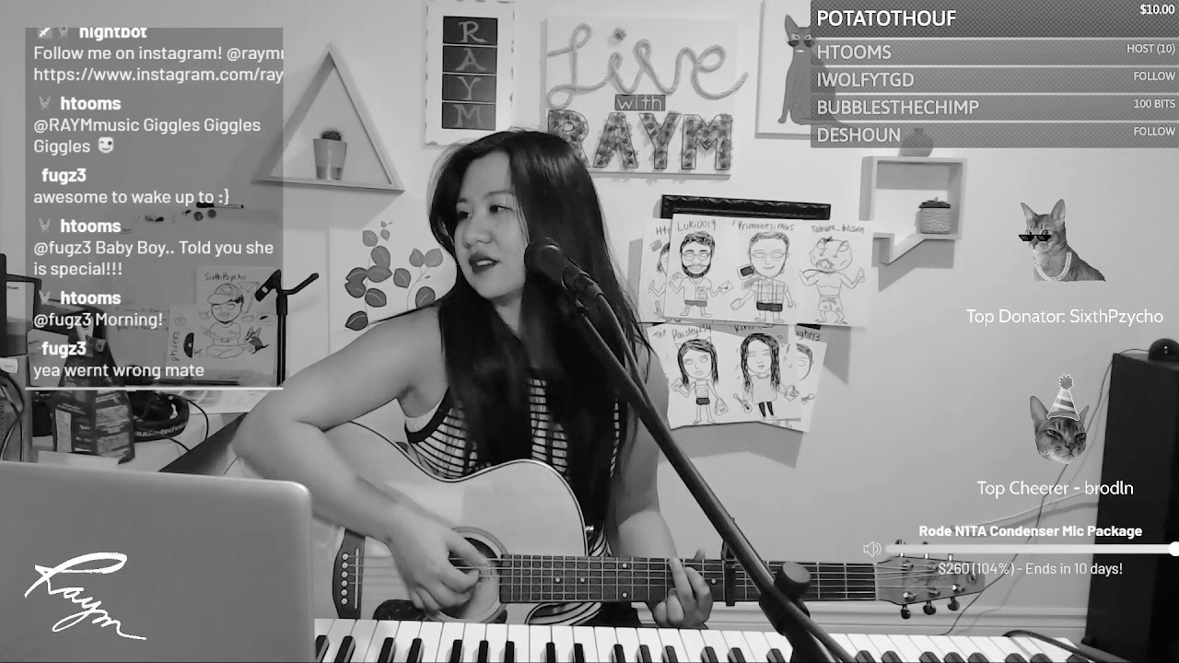
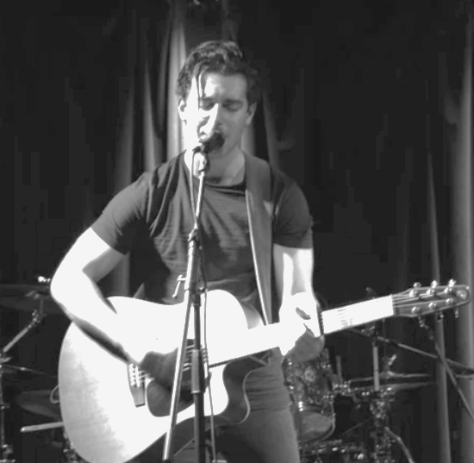
NEEDFINDING ROUND 2 artists and musician work

Slide 7

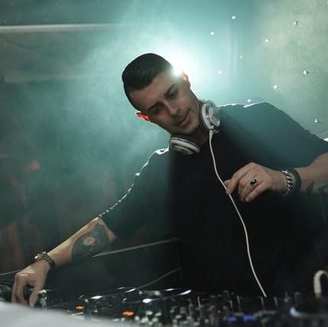
(Tension) “I’d be happiest right now if I could spend 70% of my time on my own music, and 30% on client work, but that’s not realistic.”
1
(Tension) Common to have misunderstandings b/w creators and clients that force the seller to put a lot of extra effort into pleasing the client.
2
EDM DJ
Based in Holland, Freelancer on 3 platforms, Spotify songs w/ 1M+ streams
3
(Tension) “Fiverr is really based on the buyer rather than the seller.”
Note: stock photo; our interviewee asked to remain unidentifiable
Notes:
Insights
Conflicted with client and self-work
Have to be realistic, the gigs can sometimes be the moneymakers, especially during COVID
Feels abandoned by platforms who side with buyers rather than sellers

Slide 8

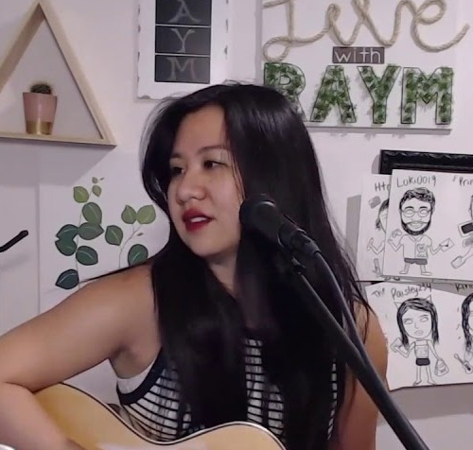
(Contradiction) Loves how Twitch raids facilitate networking, but says Twitch has not opened up opportunities; “you have to do the connecting yourself.”
1
2
(Surprise) "Some people COME for your personality, then decide to stay for your music" instead of the other way round.
RAYM
Full time Twitch Music streamer, does covers, releases on Spotify
3
(Says) “The community makes it so good for me”

Slide 9
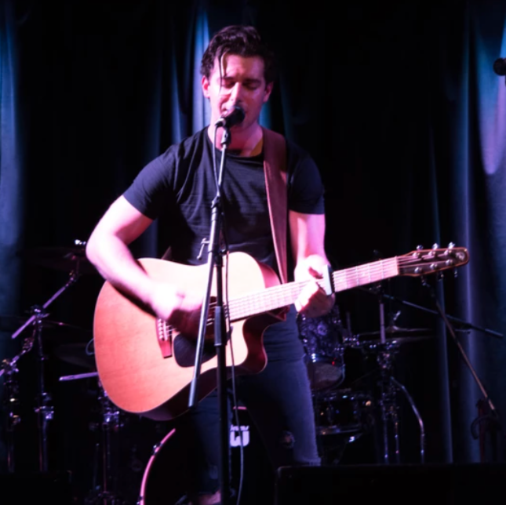
(Surprise) “Twitch is more engaging than performing live” because of intimacy
1
(Tension) Watches and reaches out to competitor streams for networking, but feels somewhat tedious and inorganic.
2
JOSH
Toronto-based touring country singer-songwriter (now on Twitch)
3
(Surprise) Listeners value the storytelling in a musical piece more than its instrumentation and melodies.

Slide 10
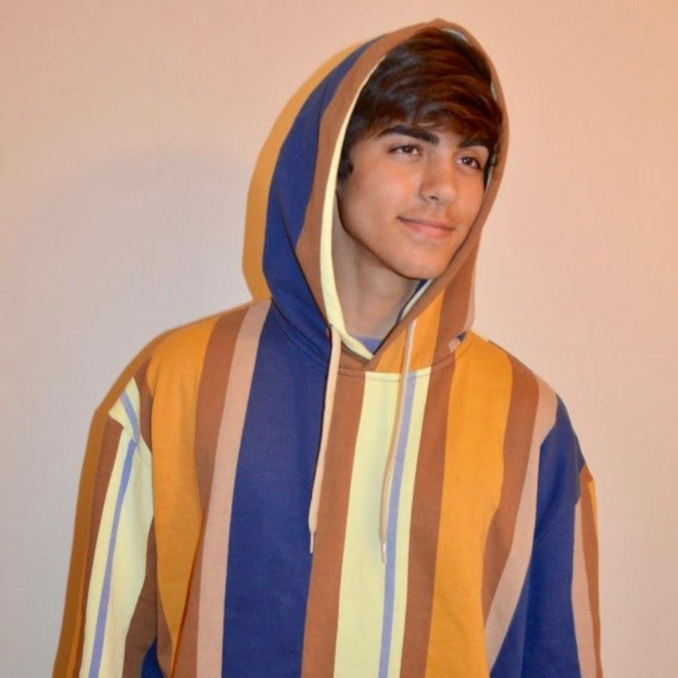
(Surprise) “I used music as a coping mechanism and outlet for my emotions.”
1
(Contradiction) Frustrated about networking, but feels the need to connect through social media
2
JAYANI
Columbia sophomore, singer-songwriter with gig experience in China and US
3
(Tension) “Connecting with fans is kinda like sending emails versus texting someone”

Slide 11
POVs & HMWs

Slide 12
POV 1
We met...
an EDM DJ who loves creating his own music, but primarily supports himself through production freelancing.
We were amazed to realize...
he spends most of his time fulfilling freelance orders for clients that don’t support his creative vision to stay afloat financially.
It would be game- changing to...
enable artists to explore creatively and support themselves financially at the same time.
Note: stock photo; our interviewee asked to remain unidentifiable
Notes:
HMW make client-work and self-work seem like one job
HMW make completing music jobs like Youtube? (creative decision, fun, etc)
HMW give creators more authority
HMW make giving creative freedom to musicians fun for clients
HMW increase job options available to creators
HMW integrate self-music with client work
HMW make musicians comfortable or feel more empowered to say “No”
HMW make dealing with clients more efficient?
HMW improve the platform of client-work to make it worth the time?
HMW eliminate the customer-fulfiller element of “orders”?
HMW make working with less clients more viable so there is more time available for self-work?
HMW support creators in different ways that don’t involve client-work?
HMW make freelancing more dependable?
HMW match clients and creators smoother through possibly style/genre?
HMW make talking to clients easier?

Slide 13
Lack of control Stressful, Unreliable, Guaranteed income
In control, Comfortable, Rely on self,
No income
HOW MIGHT WE...
Make working on client orders and one’s own music feel like one job?

Slide 14
POV 2
We met...
Josh, a touring country singer- songwriter who has shifted towards live-streaming due to COVID-19.
We were amazed to realize...
despite complaining about the tedious nature of networking, he still spends hours out of his day watching competitor streams to build his network.
It would be game- changing to...
make networking for musicians fun and frictionless.
Notes:
HMW automate networking
HMW eliminate the anxiety that comes with networking
HMW facilitate creators to network/give each other feedback
HMW integrate networking and music creating more closely
HMW build relationships between clients and creators
HMW make networking like Thanksgiving?
HMW eliminate the idea of competition?
HMW encourage creators to introduce themselves
HMW making ghosting nonexistent
HMW weave networking and music together
HMW make networking not feel like a job
HMW decrease the need for networking
HMW make networking like being a freshman on campus?
HMW make networking non-competitive
HMW improvements the platform of client-work to make it worth time

Slide 15

HOW MIGHT WE...
Eliminate the anxiety that comes with networking?

Slide 16
POV 3
We met...
RAYM, a pre-med student turned full time singer on Twitch.
We were amazed to realize...
She spends lots of stream-time re-enacting Disney movies in full costume instead of making music because “just music is not entertaining enough” for her audience.
It would be game- changing to...
showcase personality and foster community through (not in spite of) artist music.
Notes:
HMW allow more communication/interaction between creators and the audience?
HMW offer more services to keep audiences engaged?
HMW keep people engaged in other ways while still involving music? E.g. quizzes, music storytimes, podcasts?
HMW redefine professionalism?
HMW encourage creators to make music that reflect personalities?
HMW makes attract fans casual/not pressured to do so?
HMW encourage audience engagement?
HMW make music more deep and multi-dimensional?
HMW encourage creators to be more personal?
HMW tie music with an artifact of their personality in a platform?
HMW introduce more ways of interaction between fans and creators?
HMW make musical content more entertaining?
HMW express personality in other avenues that aren’t appearance/visual based (podcasts? radios?)

Slide 17
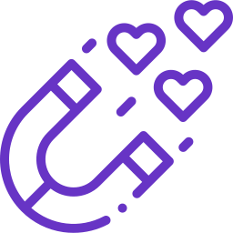
HOW MIGHT WE...
Help creators engage their audience through (not in spite of) their music?

Slide 18
solutions & experience prototypes

Slide 19
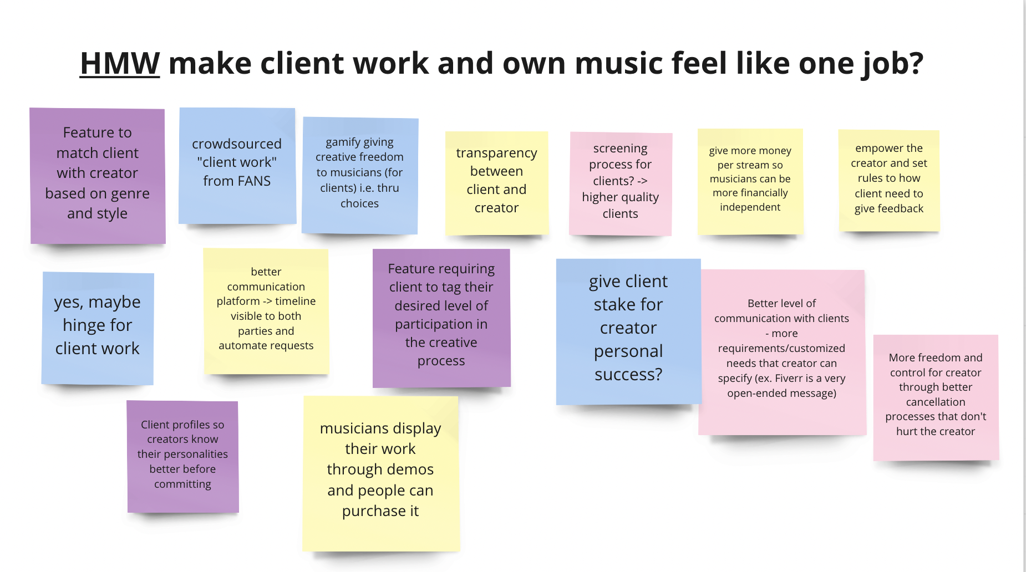
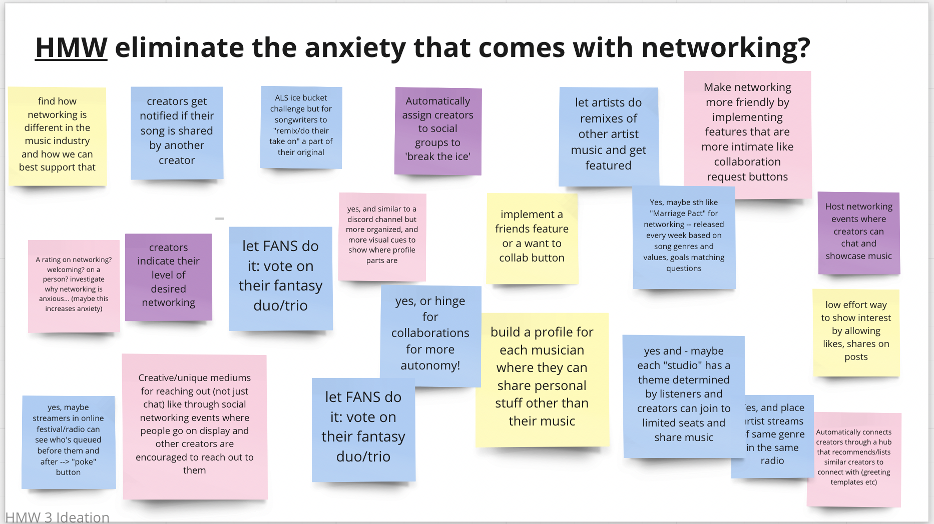
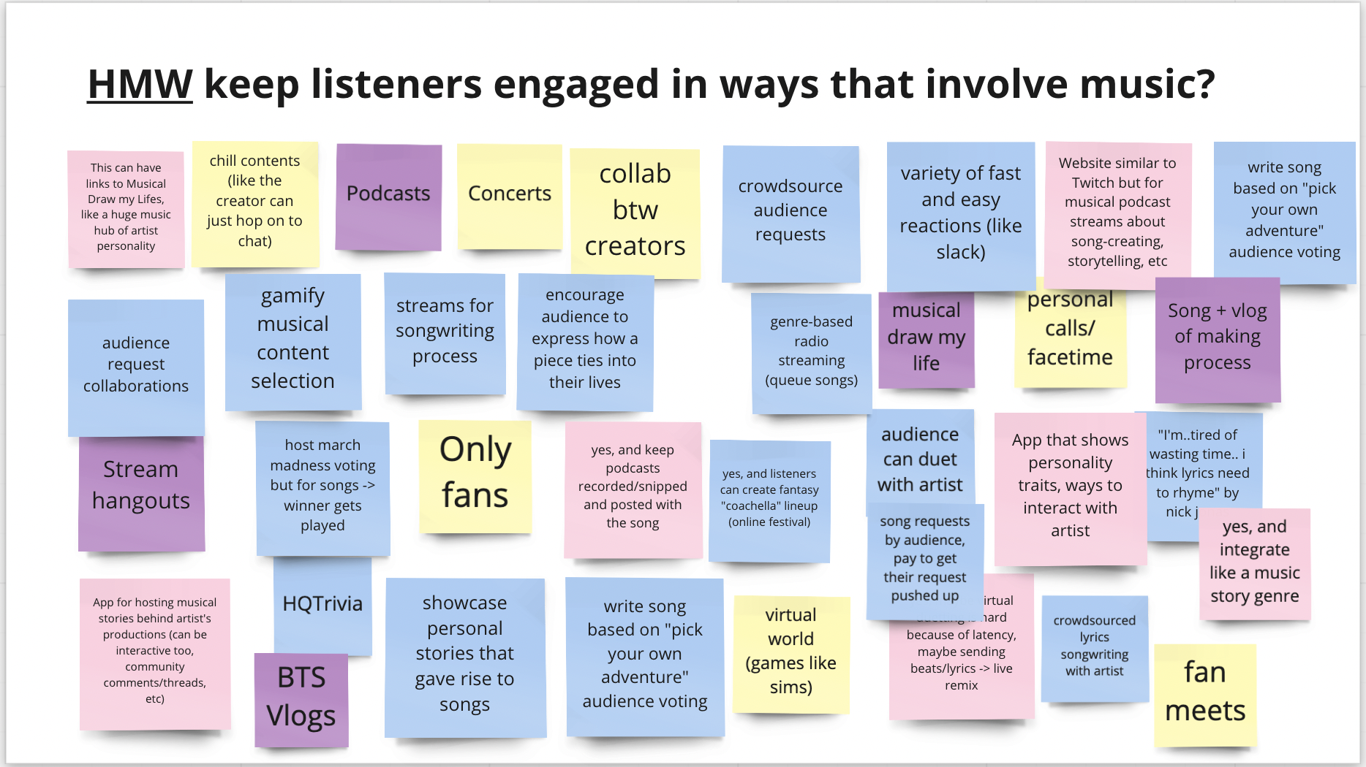
We ideated solutions for each HMW...
JPG version in team drive.
Link to Miro.

Slide 20
IDEAS SAMPLING: HOW MIGHT WE...
Make working on client orders and one’s music feel like one job?
1
Match clients and creators → Sense of collaborating, not just “fulfilling orders”
Lack of control Stressful, Unreliable, Guaranteed income
2
“Clients” invest in crowdsourced passion projects → give client stake in artist’s creative success
In control, Comfortable, Rely on self,
No income
3
Creative participation level tags on job requests → no miscommunication

Slide 21
IDEAS SAMPLING: HOW MIGHT WE...
Eliminate the anxiety that comes with networking?
1
Trains & remixes on each other’s music →
Connect artists organically through what they love to do
2
“Marriage Pact” Networking →
Automate connections based on values & data
3
Fans vote on fantasy duos/trios →
Let fans do the networking for artists

Slide 22
IDEAS SAMPLING: HOW MIGHT WE...
Help creators engage their audience through (not in spite of) their music?
1
Podcast streams on the stories behind songs →
Allows for storytelling while keeping it tied to music
2
Crowdsource lyrics from fans during live songwriting →
Engages the audience with the creator’s creative process
3
Allow audience to request artist collaborations →
Creates a connections between artists while conversing with the audience

Slide 23

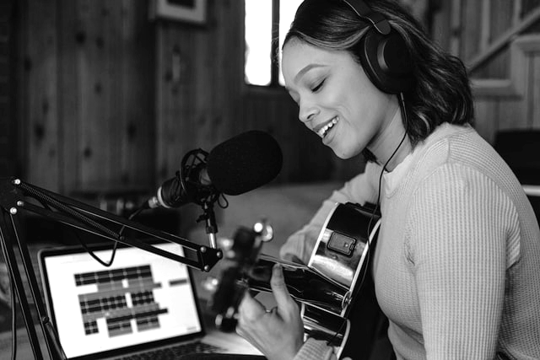
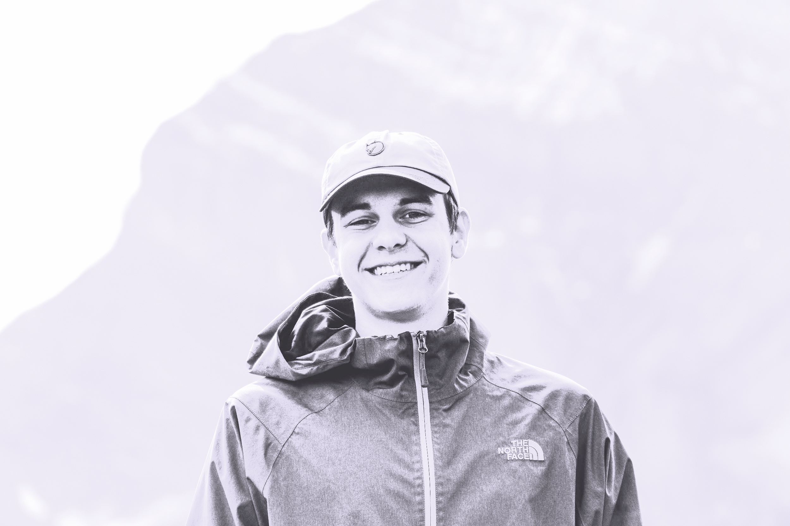
HMW MAKE WORKING ON CLIENT ORDERS AND ONE’S OWN MUSIC FEEL LIKE ONE JOB?
Collab-lance
Connect creators and clients on freelance projects that feel like collaborations through mutual, holistic, interest and understanding.
1
Filter by needs, timeline, and level of creative control
2
Read and listen to in-depth profiles one-by-one
3
Start messaging only when mutual interest expressed

Slide 24
Assumption 1
People would sacrifice time and energy if it meant getting a more customized client-creator fit
Assumption 2
Only being able to be messaged after mutual interest in working on a project alleviates stress for creators
Assumption 3
People prefer accessing less job postings in a given amount of time if it means gaining a holistic, in-depth understanding of the people they work with.

Slide 25
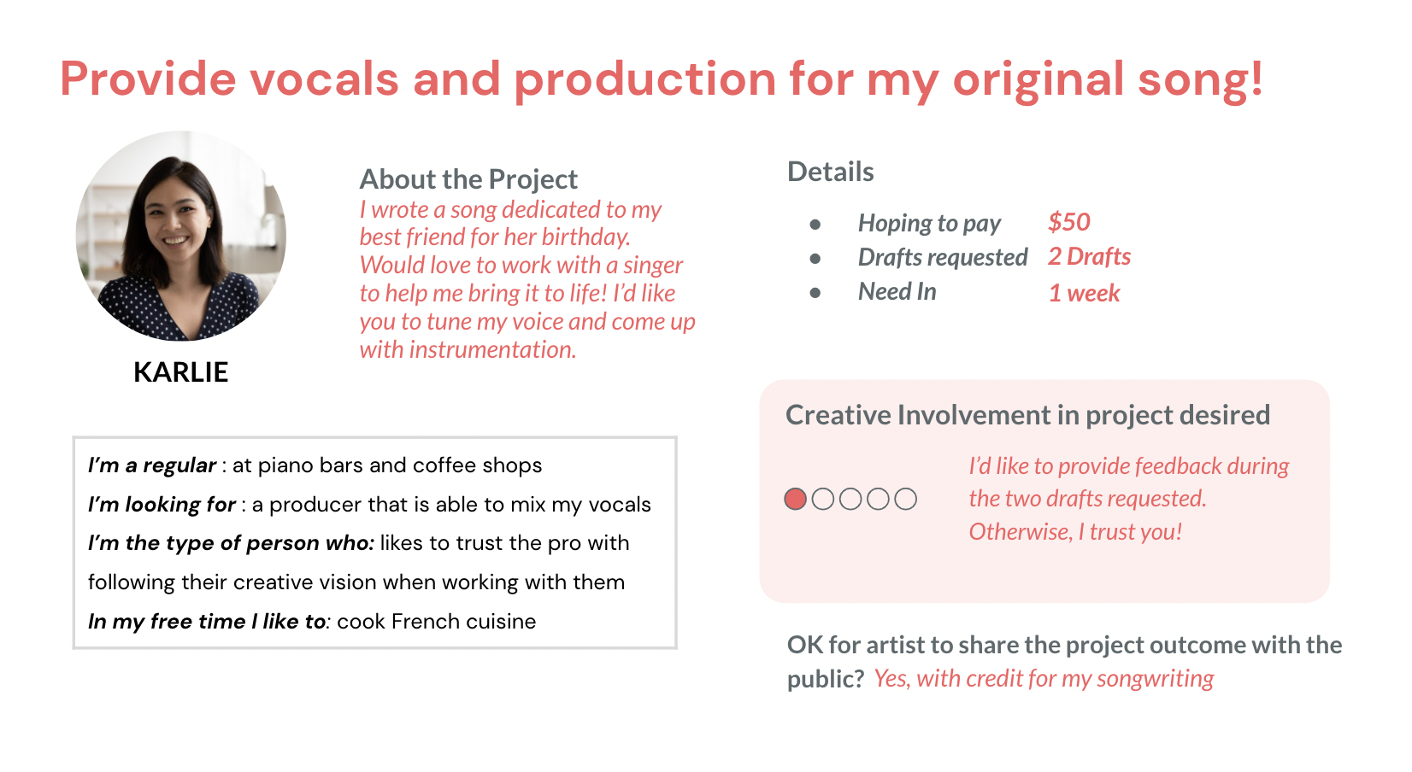
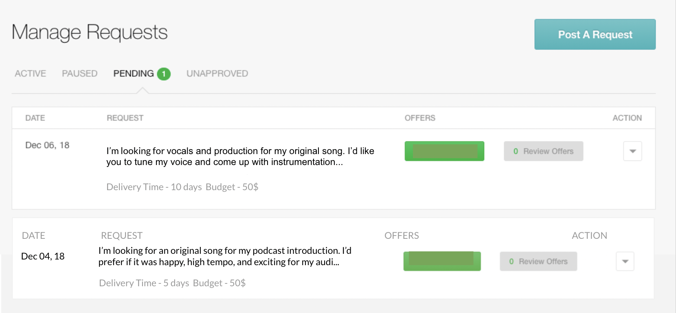
Collab-lance Assumption: people prefer accessing less job postings in a given amount of time if it means understanding a potential client from a holistic, in-depth perspective.
In-depth profiles of jobs AND the clients posting them, displayed one by one
vs.
Wide breadth of job requests with shallow to no information on the client

Slide 26
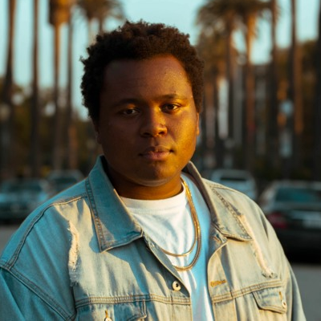
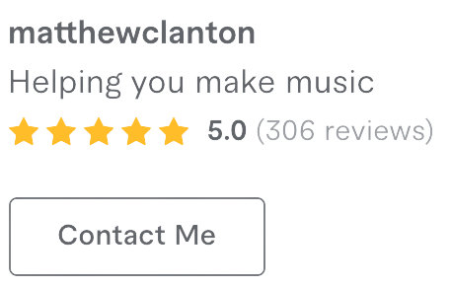
Collab-lance Assumption: people prefer accessing less job postings in any given amount of time if it means understanding a potential client from a holistic, in-depth perspective.
LA-based musician
Quit job to become a full-time freelancer
This has opened up a lot of free-time for him

Slide 27

COLLAB-LANCE EXPERIENCE PROTOTYPE RESULTS
What went well
Prefers in-depth profile order→ Confirmed assumption!
Not filtered by orders delivered → great for new creators
“Cool, cool,” vs. expressionless

Slide 28



COLLAB-LANCE EXPERIENCE PROTOTYPE RESULTS
What didn’t go well, surprises, and new learnings
Still stressed about technical language barrier
Creative Involvement was most important element
Want to understand clients through music listening patterns (i.e. link Spotify)

Slide 29



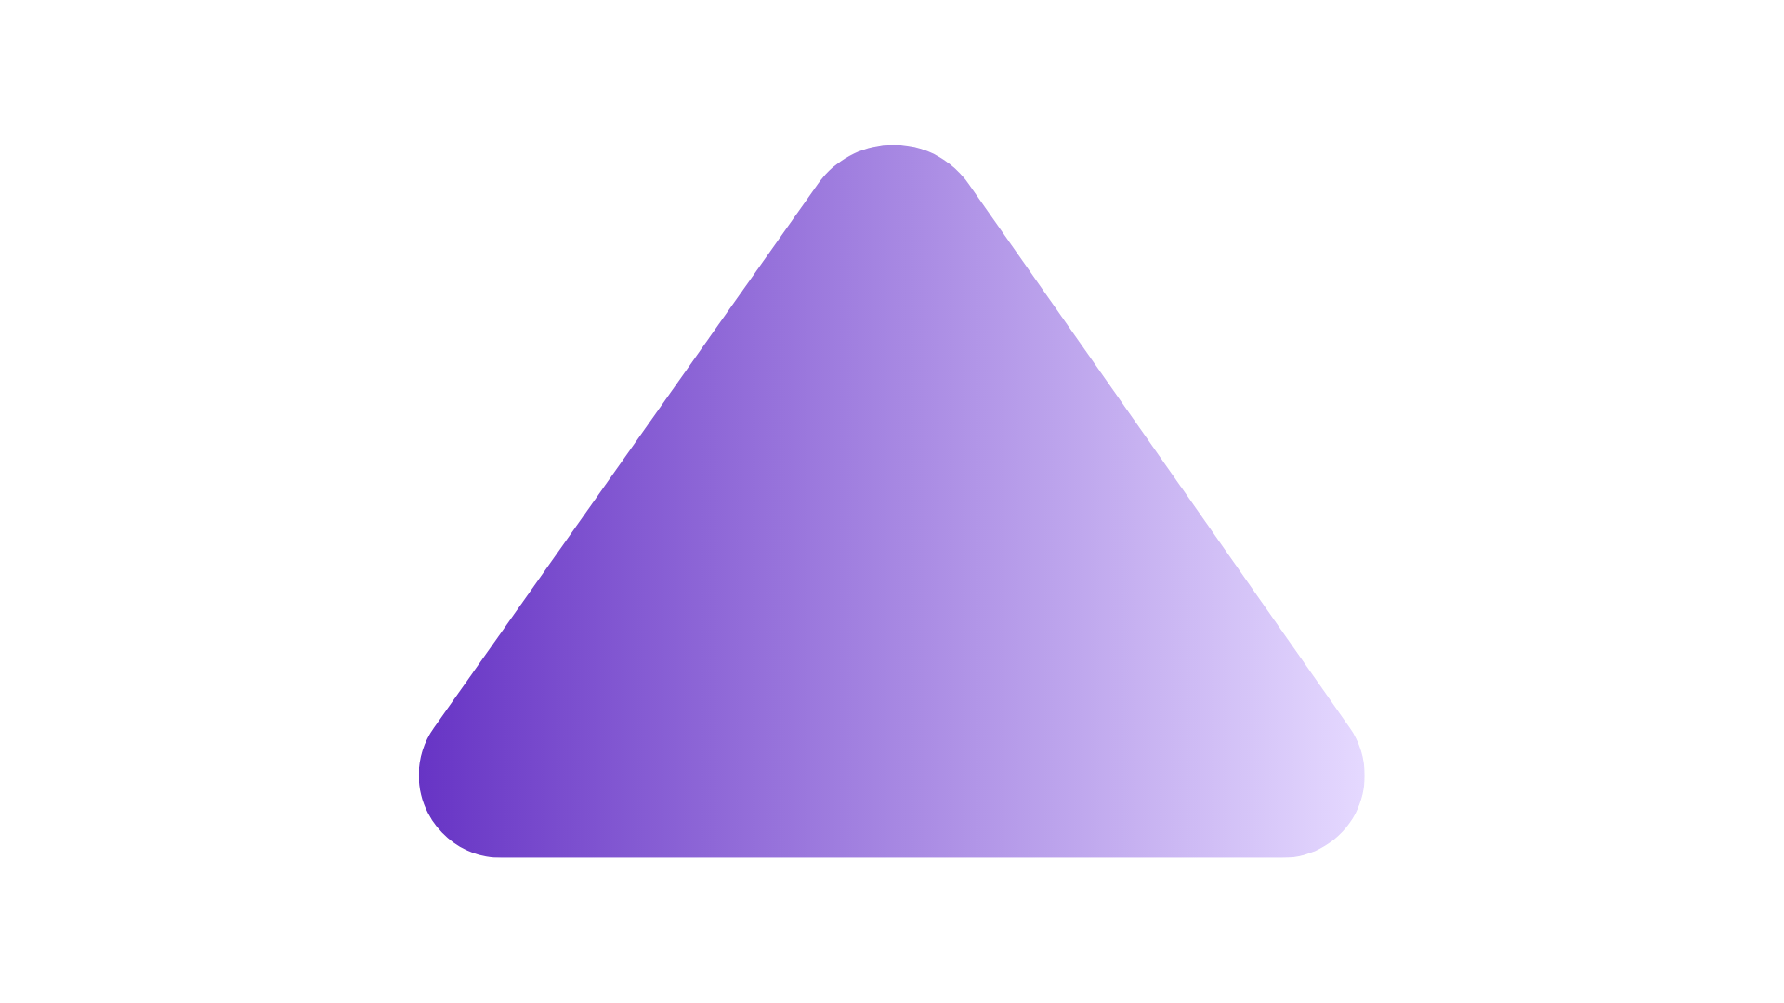
HMW ELIMINATE THE ANXIETY THAT COMES WITH NETWORKING?
30-second Playground
Socialize musically: send and reply to 30-second musical messages of creative, interlocking wildness
1
Create a 30-second musical message and release it to the playground
2
Dream up a musical reply
by layering over, remixing, or covering others’ soundbytes.
3
Ice is broken → make the connection Through frictionless social and DM buttons

Slide 30
Assumption 1
A creator will want to connect with people that duet them
Assumption 2
People will enjoy and want to share 15 second remixes
Assumption 3
30-second commitments feel low-stake, fun, and can recharge creative energy

Slide 31
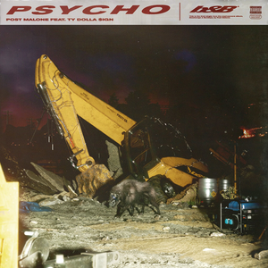

30-second Playground Assumption Tested: 30-second commitments feel low-stake, fun, and can recharge creative energy
Would you be able to lay over, remix, or cover this 30-second sound-byte?
How did that feel?

Slide 32
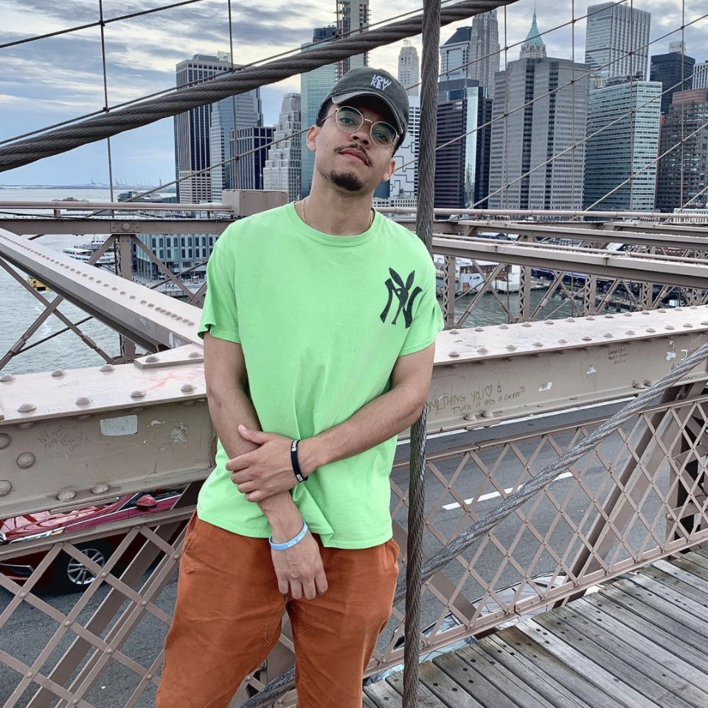
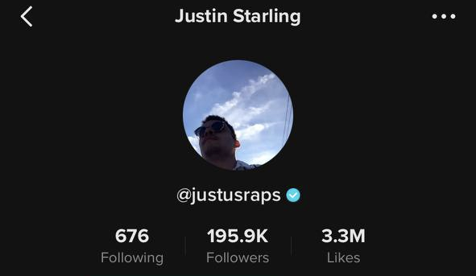
30-second Playground Assumption Tested: 30-second commitments feel low-stake, fun, and can recharge creative energy
Producer & rapper
Viral on Tik Tok
Released a new song every week (!) in 2019

Slide 33

30-SECOND PLAYGROUND EXPERIENCE PROTOTYPE RESULTS
What went well
Before: enthusiastically agreed → feels undaunting, exciting
After: “Fun working in ‘Stanford’” → confirmed assumption!

Slide 34
COLLAB-LANCE EXPERIENCE PROTOTYPE RESULTS
What didn’t go well, surprises, and new learnings
Not everyone (i.e. perfectionists) would find the process short and stress-free
Freestyle primarily based not on the beat, but the emotions he’s feeling in the song
Adding non-creators to the equation can increase incentive to share bc direct success then becomes a product of the “networking”

Slide 35
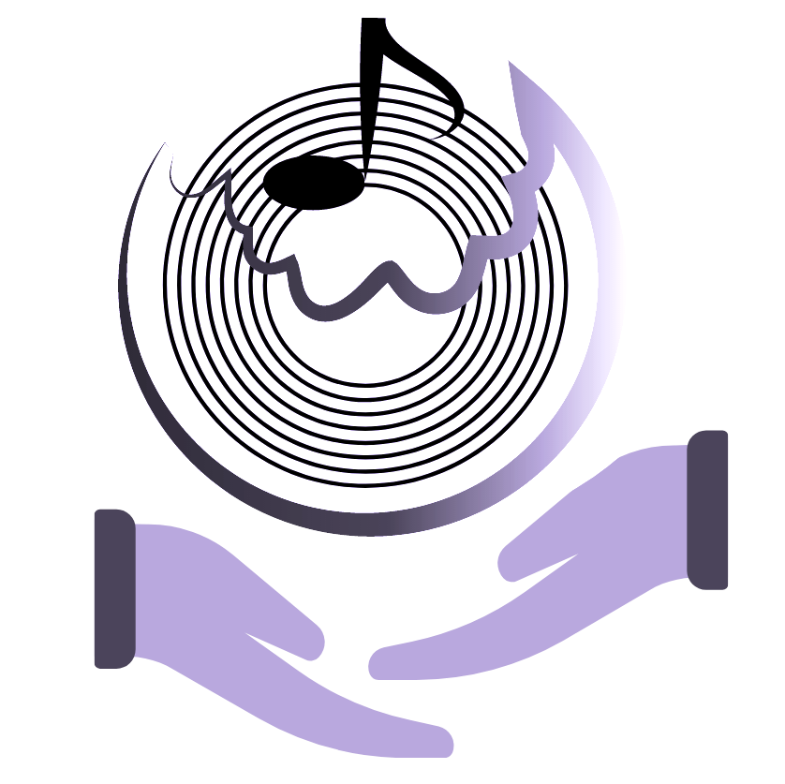
HMW MAKE CLIENT WORK AND THEIR OWN MUSIC FEEL LIKE ONE JOB? (SOLN 2)
TUNEstart
Re-imagines “clients” as investors with a stake in the artist’s creative success; invest in their passion projects to contribute creative ideas
1
Create a concept for a musical project and release it to the TUNEstart platform
2
“Clients” back the project with donations for chance to contribute creatively
3
”Clients” are invested in the artist’s success
because they are given a stake in it.

Slide 36
Assumption
Artists will be willing to share creative control of their project in return for funding
Assumption
People will trust the posters are genuine about investing the crowdsourced funds into passion projects they posted about if they know the story behind it
Assumption
People will be interested in funding smaller, unknown artists in the scope of artists with more following IF they can have more creative involvement.

Slide 37
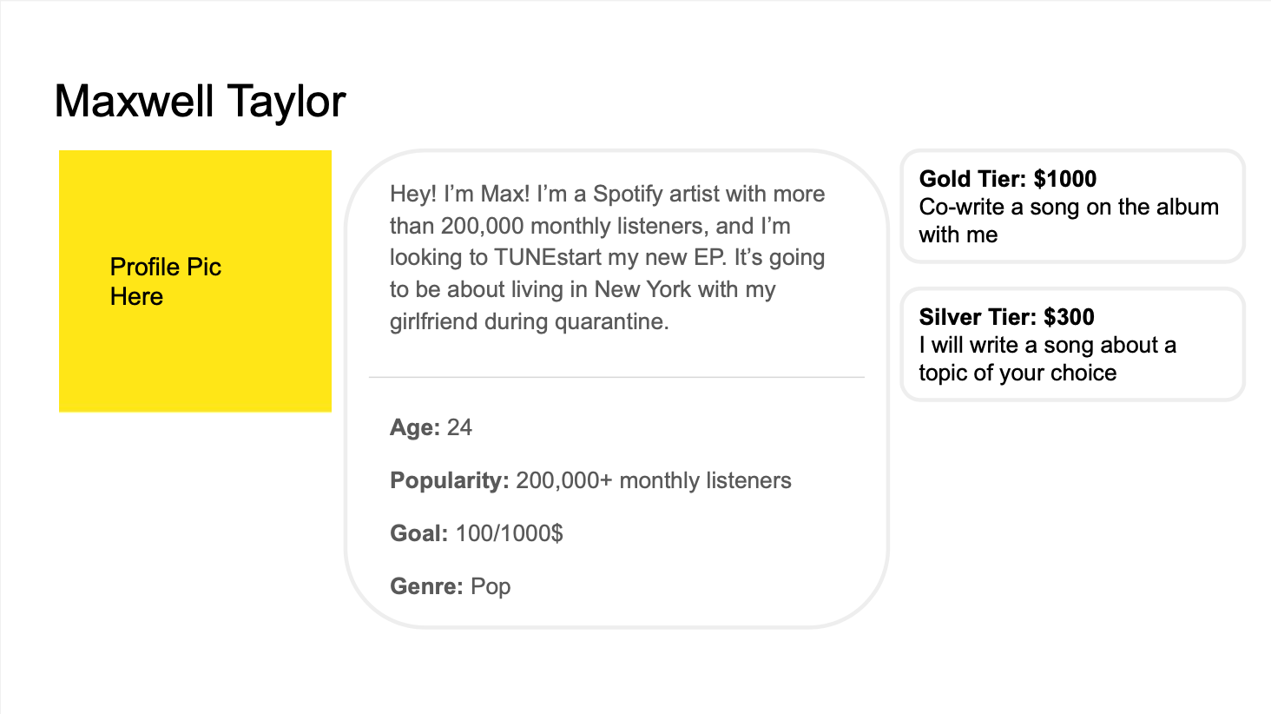
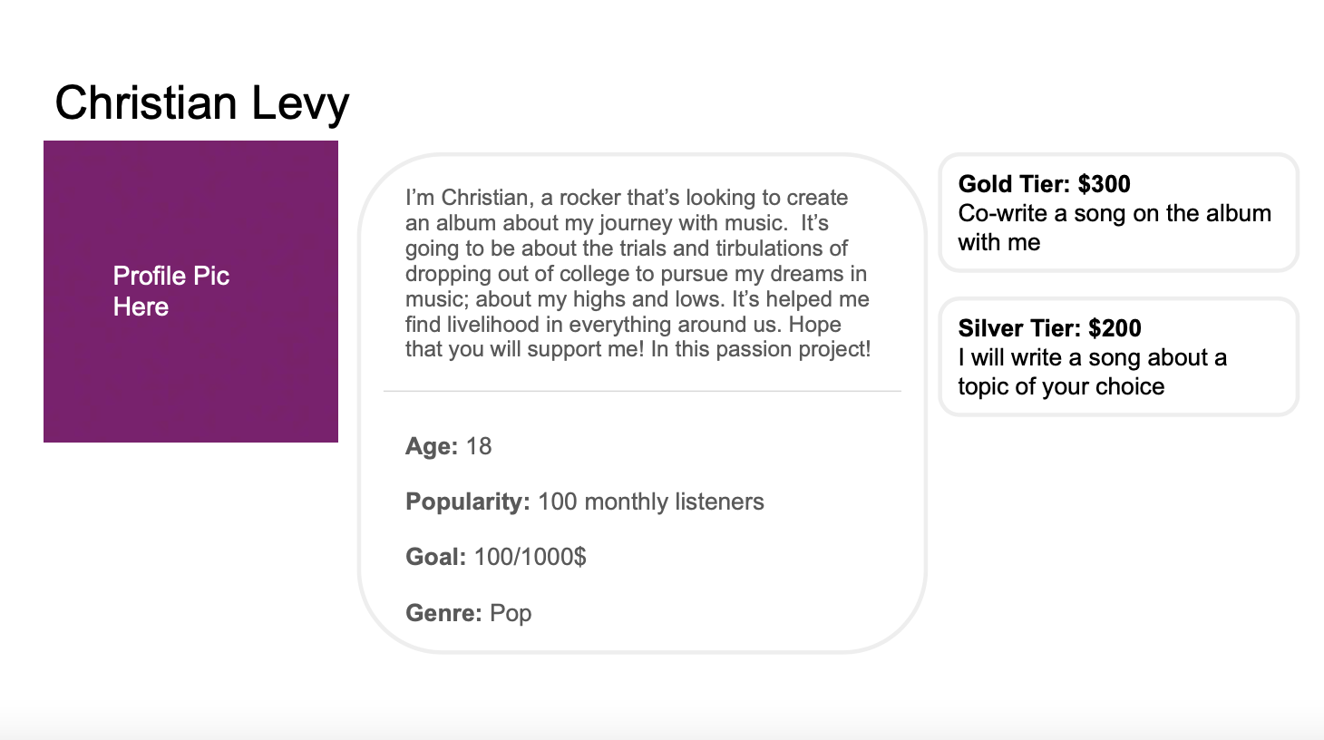
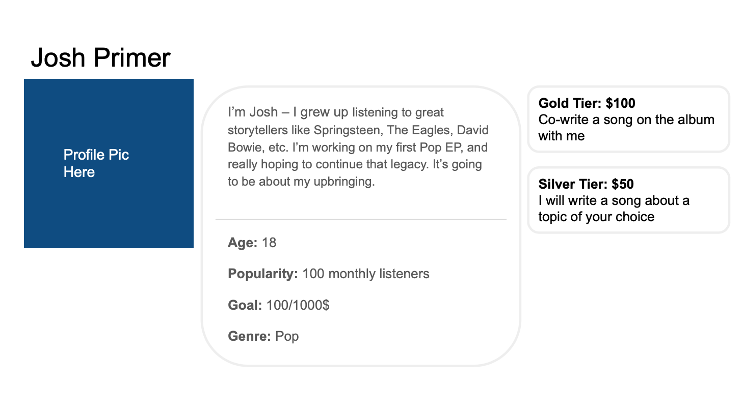
TUNEstart Assumption Tested: People will be interested in funding smaller, unknown artists in the scope of artists with more following if they can have more creative involvement.
Small creator
Large creator

Slide 38
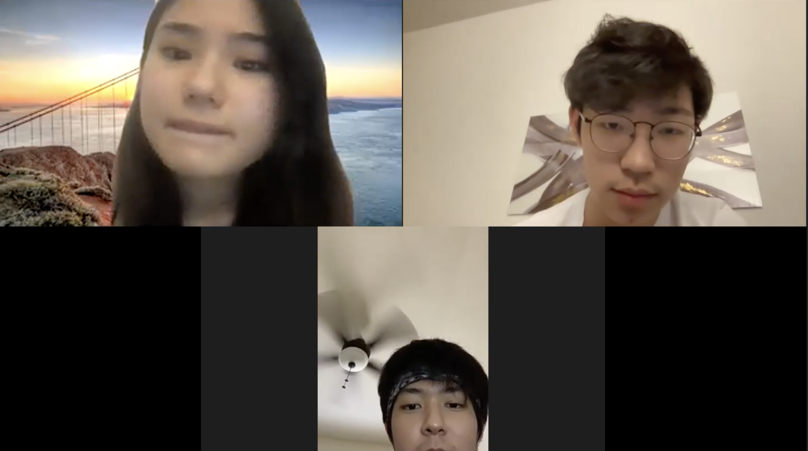
TUNESTART EXPERIENCE PROTOTYPE RESULTS
Results
Lower contribution tiers increased willingness to donate! → half-confirmed assumption
Lots of kids these days are like Josh Prime… Obviously everyone starts somewhere, but it all comes down to what his music sounds like
Michael couldn’t trust the music quality of small creators
Music dabblers prefer giving to small artists because they can relate
MICHAEL M.
Stanford Sophomore
EarthSys Major
Amateur Guitarist
People need to hear samples otherwise, nothing matters
Notes:
“Lots of kids these days are like Josh Prime… Obviously everyone starts somewhere, but it all comes down to what his music sounds like”

Slide 39
Evaluating the solutions (we’d love to hear your input!)
 | Frequency How often does the problem it solves occur? | Density Do lots of people experience it? | Interest Average of our interest ratings
Collab-lance Matching for projects to relieve qualms associated with freelancing | High for full-time freelancers; on every order that supports their livelihood. | High All freelancers we expressed this internal conflict; there are 80,000+ freelancers in US and Canada (afm.org)
30-second playground Network playfully, musically, non-tediously | Low Networking is not on everyone’s mind, so feeling of tediousness not as prevalent. | Medium Based on interviews, it seems that need to network is not AS prevalent in producers.
TUNEstart Give clients a stake in the creative success of freelancers | High for full-time freelancers; on every order that supports their livelihood. | High All freelancers we expressed this internal conflict; there are 80,000+ freelancers in US and Canada (afm.org)

Slide 40
Evaluating the solutions (we’d love to hear your input!)
 | Frequency How often does the problem it solves occur? | Density Do lots of people experience it? | Interest Average of our interest ratings
Collab-lance Matching for projects to relieve qualms associated with freelancing | High for full-time freelancers; on every order that supports their livelihood. | High All freelancers we expressed this internal conflict; there are 80,000+ freelancers in US and Canada (afm.org)
30-second playground Network playfully, musically, non-tediously | Low Networking is not on everyone’s mind, so feeling of tediousness not as prevalent. | Medium Based on interviews, it seems that need to network is not AS prevalent in producers.
TUNEstart Give clients a stake in the creative success of freelancers | High for full-time freelancers; on every order that supports their livelihood. | High All freelancers we expressed this internal conflict; there are 80,000+ freelancers in US and Canada (afm.org)
We like that it that this solution leverages the universal feeling of protectiveness and pride in things we had a hand in making to support artists and their passions.

Slide 41
Key Learnings
Creators want personalized client matches for a better freelancing experience
30-second musical networking can be stress-free and fun, but not for everyone (perfectionists)
Creative involvement is a powerful incentive to invest, but the decisive factor is in the music itself

Slide 42
appendix

Slide 43
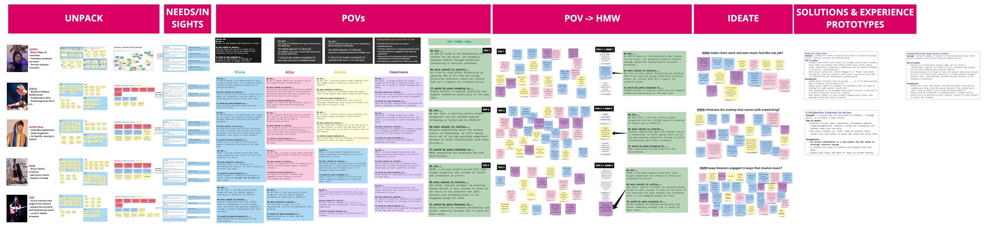
Appendix Info
Some slides before the appendix were not presented for time (8, 10, 20, 21, 22)
Consent Forms
Additional needfinding & experience prototype guides + artifacts in folder.
Miro Workspace with ALL ANALYSIS (JPG version, Miro Board)
We also conducted an additional experience prototype that was omitted due to time constraints (flip deck to view)

Slide 44
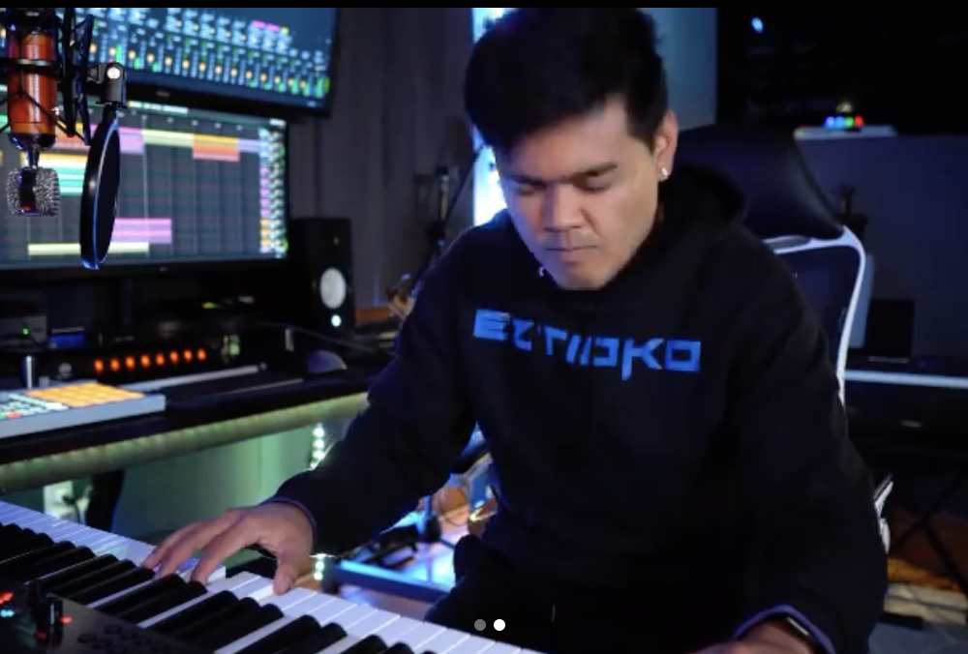
Estioco: Playground experience prototype results
Validated our assumptions
Artists enjoy making short, “causal” music that gives them a break from client work and allow them to build connections from it
Revealed other considerations we should make
Not all artists (i.e. perfectionists) would find the process short and stress-free
15-second time limit could be too short, depending on the song → changed to 30-second for Justin Starling
Next steps
Possibly try testing the same process with other time limits
Look for ways to incorporate the other ideas to combat this problem thoroughly
Dustin (Legal Name David)
DJ Remixer
TikTok and Spotify
Frequently remixes songs

